Slide 1
Boosting Algorithms

Slide 2
Boosting algorithm
Boosting is one kind of ensemble learning.
It trains the model sequentially.
Each new model tries to correct the previous model.
Two most popular algorithm
Ada boosting algorithm
Gradient Boosting
These algorithm can be used for regression and classification.

Slide 3
Gradient Boosting Algorithms

Slide 4
Gradient Boosting algorithm
Each new model is trained to minimize the loss function .
It trains the model sequentially.
the algorithm computes the gradient of the loss function with respect to the predictions of the current ensemble and then trains a new weak model to minimize this gradient.
The predictions of the new model are then added to the ensemble, and the process is repeated until a stopping criterion is met.

Slide 5
Gradient Boosting algorithm
Each new model is trained to minimize the loss function .
It trains the model sequentially.
the algorithm computes the gradient of the loss function with respect to the predictions of the current ensemble and then trains a new weak model to minimize this gradient.
The predictions of the new model are then added to the ensemble, and the process is repeated until a stopping criterion is met.
Shrinkage refers to the fact that the prediction of each tree in the ensemble is shrunk after it is multiplied by the learning rate (eta) which ranges between 0 to 1.

Slide 6
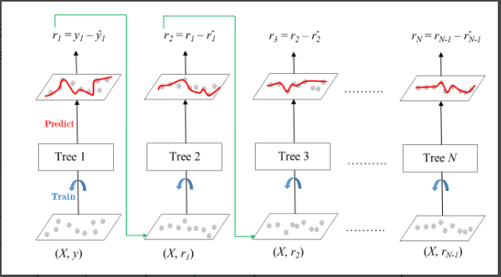
GradientBoosting algorithm

Slide 7
Gradient Boosting algorithm - Parameters
Loss:
Ranges:‘squared_error’, ‘absolute_error’, ‘huber’, ‘quantile’
Default:squared_error
learning_rate:
float
default=0.1
n_estimators:
int
default=100
Subsample:
float
default=1.0 values must be in the range (0.0 to 1.0)
Criterion
Range:‘friedman_mse’, ‘squared_error’ default:’friedman_mse’
min_samples_split:
int or float
default=2 (2 to inf) or (0.0 to 1.0)

Slide 8
Gradient Boosting algorithm - Parameters
min_samples_split:
int (1 to inf) or float (0.0 to 1.0),
default=2
max_depth:
int or None
default=3
min_impurity_decrease:
Float
default=0.0
Init:
Estimator or ‘zero’,
default=None
random_state:
Int
RandomState instance or None,
default=None
n_iter_no_change:
int
default=None
Tol:
Float
default=1e-4

Slide 9
Gradient Boosting algorithm - Parameters
max_features:
Range: {‘sqrt’, ‘log2’}, int or float
default=None
Alpha:
Float
default=0.9
Verbose:
int,
default=0
max_leaf_nodes:
Int [2 to inf]
default=None
warm_start:
Bool
default=False
validation_fraction:
float,
default=0.1
ccp_alpha:
non-negative float
default=0.0

Slide 10
ExtremeGradient(XG) Boosting Algorithms

Slide 11
XG Boosting algorithm
XGBoost is a scalable and highly accurate implementation of gradient boosting that pushes the limits of computing power for boosted tree algorithms
In XGBoost, trees are built in parallel, instead of sequentially like GBDT. .
XGBoost is a powerful approach for building supervised regression models.

Slide 12
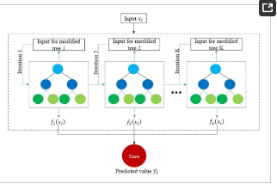
XG Boosting algorithm - Parameters

Slide 13
XG Boosting algorithm - Parameters
objective:
Reg:linear
N_estimators
Int

Slide 14
Light Gradient Boosting Machine Algorithm

Slide 15
LightGBM algorithm
It is a high performance gradient boosting algorithm
It creates a decision tree that develop leafwise that is given a condition, just one leaf is split, depending on the benefit
leaf-wise trees might overfit. Overfitting can be prevented by limiting the tree depth. .

Slide 16
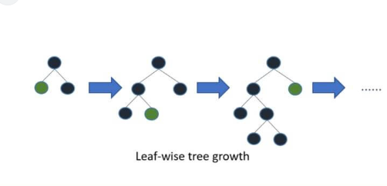
Light GBM algorithm

Slide 17
Ada Boost Algorithms

Slide 18
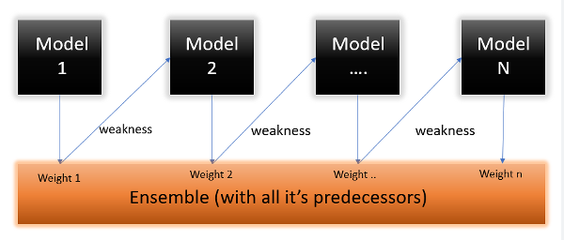
Adaboost Regressor

Slide 19
Adaboost Regressor
It is an ensemble machine learning algorithm.
It can be used for classification and regression scenarios.
This model fits regressor on the original dataset and then fits the additional copies of regressor on the same dataset.
Each time weight is adjusted according to the error of the current prediction.

Slide 20
Parameters
N_estimators:
default value: 50
Loss:
default value: linear
ranges: linear, square,exponential
Random_state:
default:None

Slide 21
Attributes
Estimator_weights_
Random_state:
default:None
b

Slide 22
Thank you

